Slide 1
Hard Disk drive evolution

Slide 2
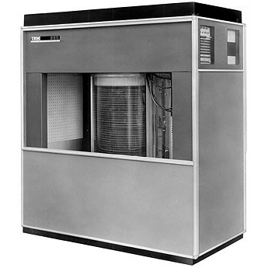
1950-1970s
The IBM 350 Disk File was developed under the code-name RAMAC by an IBM San Jose team led by Reynold Johnson. It was announced in 1956 with the then new IBM 305 RAMAC computer. A variant, the IBM 355 Disk File, was simultaneously announced with the IBM RAM 650 computer. an enhancement to the IBM 650.
IBM 350

Slide 3
1950-1970s
The IBM 350 drive had fifty 24-inch (0.6 m) platters, with a total capacity of five million 6-bit characters (3.75 megabytes). A single head assembly having two heads was used for access to all the platters, yielding an average access time of just under 1 second.

Slide 4
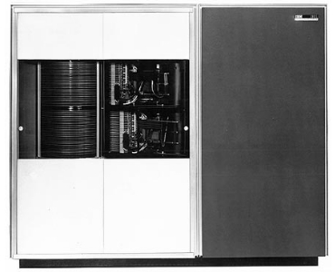
1950-1970s
The RAMAC disk drive created a new level in the computer data hierarchy, today known as secondary storage, less expensive and slower than main memory (then typically core or drum) but faster and more expensive than tape drive. Subsequently there was a period of about 20 years in which other technologies competed with disks in the secondary storage marketplace, for example tape strips, e.g., NCR CRAM, tape cartridges, e.g., IBM 3850, and drums, e.g., Burroughs B430, UNIVAC FASTRAND, but all ultimately were displaced by HDDs. Today SSDs compete with HDDs in the marketplace.
IBM 1301 disk storage unit(1961)

Slide 5
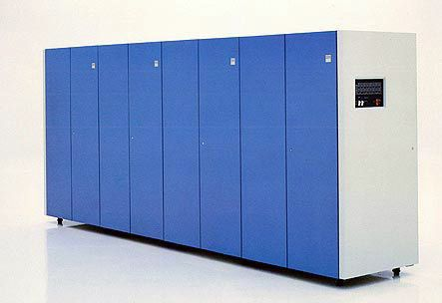
1980s, THE transition to the pc era
The 1980s saw the minicomputer age plateau as PCs were introduced. Manufacturers such as DEC and Hewlett-Packard continued to manufacture minicomputer compatible hard drive systems as industry demanded higher storage. Hewlett-Packard introduced the HP 7935 as one such drive. But it was clear that smaller Winchester storage systems were eclipsing large platter hard drives.
HDDs continued to get smaller with the introduction of the 3.5-inch form factor in the middle of the decade Rodime 1983 and the 2.5-inch form factor PrairieTek 1988.
IBM 3380 Direct Access Storage Device

Slide 6

1990s
Even though there were a number of new entrants, industry participants continued to decline in total to 15 in 1999. Unit volume and industry revenue monotonically increased during the 1990s to 174 million units and $26 billion.
Toshiba Tanba hard drive

Slide 7
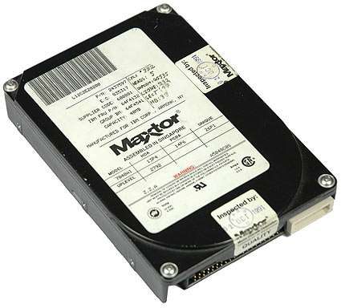
1990s
The industry production consolidated around the 3.5-inch and 2.5 inch form factors; the larger form factors dying off while several smaller form factors were offered but achieved limited success, e.g. HP 1.3-inch Kittyhawk, IBM 1-inch Microdrive, etc..
Maxtor 7040A

Slide 8
2000 - present
In 2001 the HDD industry experienced its first ever decline in units and revenue.
The number of industry participants decreased to 6 in 2009 and 3 in 2013.
Unit production peaked in 2010 at about 650 million units. Unit shipment has been in a slow decline since then, shipping about 276 million units in 2018 with a somewhat slower decline projected thereafter.[17]

